Slide 1

AIRISM
SAMUTSARI:
A Barangay Digital Marketplace and Skills Hub

Slide 2

AIRISM
HOME
ABOUT
CONTACT
OTHERS
PROJECT OVERVIEW
Community-based e-commerce platform for local vendors, service providers, and residents
Centralized hub for showcasing products, services, and customer feedback
User-friendly interface with secure digital payment options (e.g., GCash, Maya, COD)
Aims to strengthen the local economy and foster community participation

Slide 3


AIRISM
HOME
ABOUT
CONTENT
OTHERS
TARGET
USERS

Slide 4
AIRISM
HOME
ABOUT
CONTENT
OTHERS
BRGY. STA TERESITA (QUEZON CITY)
🧍 Stable Population Base
11,776 residents as of 2020 — a sizable and active local market.
🏘️ Strong Household Structure
2,034 households with an average of 4.10 members.
Ideal for promoting both individual and family-oriented services.
📊 Manageable Market Size
Represents 0.40% of Quezon City — small enough to manage but big enough to scale.

Slide 5
AIRISM
HOME
ABOUT
CONTENT
OTHERS
MISSION
&
VISION

Slide 6
AIRISM
HOME
ABOUT
CONTENT
OTHERS
MISSION
Our mission is to empower local communities by creating a simple, accessible, and affordable digital marketplace that connects residents with vendors, freelancers, and service providers. We aim to provide a trusted platform where people can buy, sell, and trade goods and services with ease, while also promoting digital literacy, encouraging entrepreneurship, and fostering stronger community connections.

Slide 7
AIRISM
HOME
ABOUT
CONTENT
OTHERS
VISION
Our vision is to build a sustainable, community-led platform that strengthens local economies and opens new opportunities for collaboration and growth in every barangay. We aim to uplift small business owners, give residents the tools to succeed in the digital space, and promote wider participation by creating a trusted system where communities can progress together and secure lasting prosperity.

Slide 8
AIRISM
HOME
ABOUT
CONTENT
OTHERS
OBJECTIVES

Slide 9
AIRISM
HOME
ABOUT
CONTENT
OTHERS
GENERAL OBJECTIVES
The general objective of the team is to develop a community-based e-commerce web platform that connects local vendors, freelancers, and service providers with residents, while promoting secure transactions, affordable logistics, and inclusive digital participation.

Slide 10
AIRISM
HOME
ABOUT
CONTENT
OTHERS
SPECIFIC OBJECTIVES
1. To develop a user-friendly e-commerce website that functions smoothly on both desktop and mobile devices.
2. To provide a central hub where vendors and service providers can showcase products, services, availability, and customer feedback.
3. To integrate secure and convenient digital payment methods such as GCash, Maya, and Cash-on-Delivery.

Slide 11
AIRISM
HOME
ABOUT
CONTENT
OTHERS
SPECIFIC OBJECTIVES
4. To introduce affordable and efficient logistics support, including subscription options for essentials, and real-time tracking.
5. To promote digital inclusion through basic training modules that enhance residents’ skills in online selling, customer service, and digital literacy.

Slide 12
AIRISM
HOME
ABOUT
CONTENT
OTHERS
BUSINESS MODEL & MONETIZATION

Slide 13
AIRISM
TRANSACTION FEES
PROMOTIONAL AD SPACES
VALUE-ADDED SERVICES
LOGISTICS SERVICE FEES
A small service fee per successful transaction to sustain platform maintenance and upgrades.
Local businesses can pay to feature their products or services on the homepage and barangay promotions.
Subscription packages for essentials (e.g., water, rice, LPG).
Shared revenue with deliveries fees

Slide 14
AIRISM
HOME
ABOUT
CONTENT
OTHERS
SYSTEM ARCHITECTURE

Slide 15
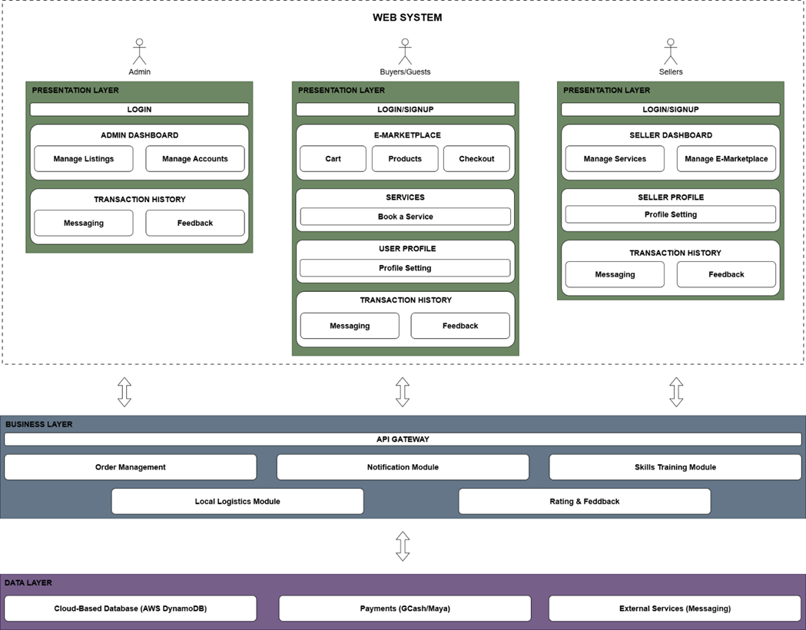
AIRISM

Slide 16
AIRISM
HOME
ABOUT
CONTENT
OTHERS
SYSTEM
OVERVIEW

Slide 17
AIRISM
TECH
STACK
SYSTEM SPECIFICATIONS
MERN Stack
E-Marketplace
Skill Trade
Local Logistics
Community- Friendly Interface
USERS
Guest
Consumers
Vendors
Admin

Slide 18
AIRISM
HOME
ABOUT
CONTENT
OTHERS
SYSTEM
DEMONSTRATION

Slide 19
AIRISM
HOME
ABOUT
CONTACT
OTHERS
THANK YOU

